Slide 1
Physiolibrary v1.0
Marek Matejak

Slide 2
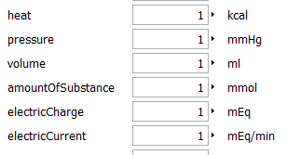
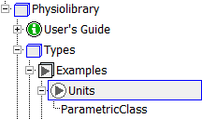

Types
Dymola display units setting:
copy Resources\DymolaSettings\displayunit.mos
to C:\Program Files\Dymola 2014\insert\
Example – parameters in display units:

Slide 3
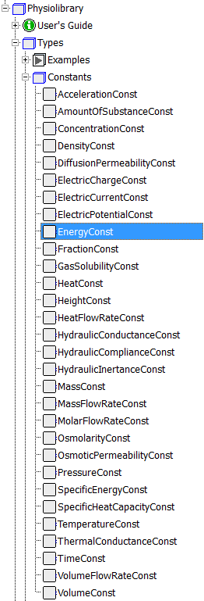
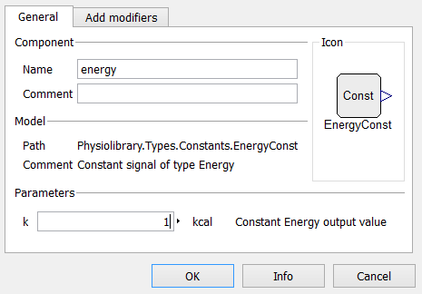
Types.Constants

Slide 4

Icons

Slide 5
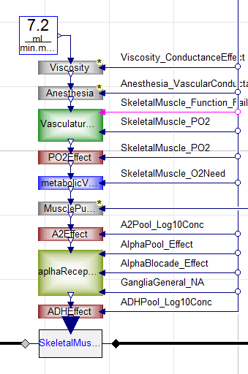
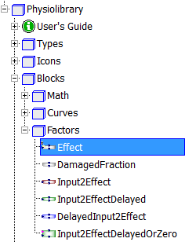
Blocks.Factors

Slide 6
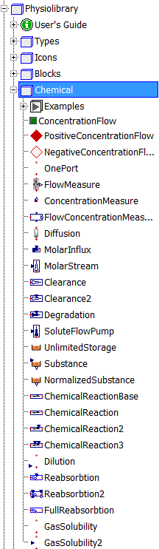

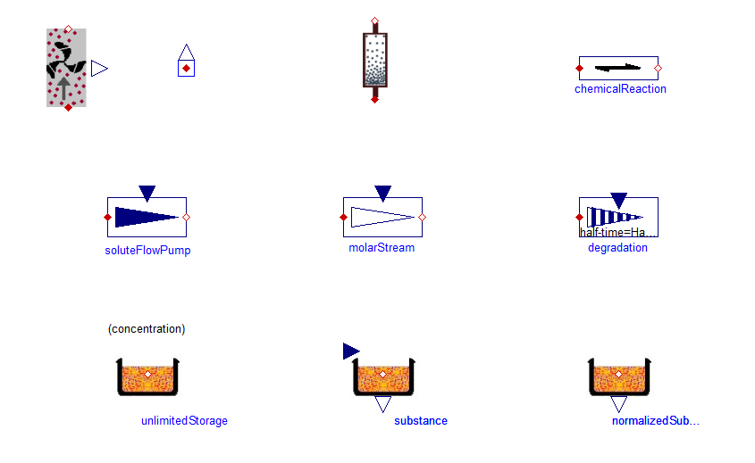
Chemical

Slide 7
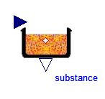
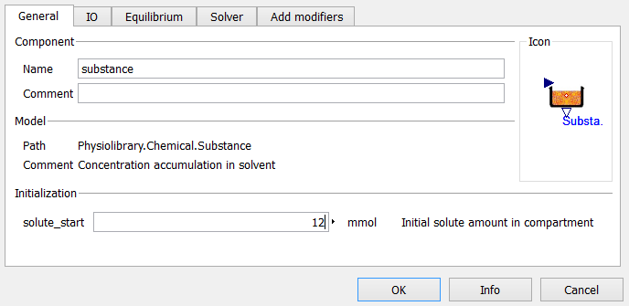
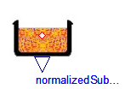
Chemical.Substance
Non-equilibrium behavior:
q_out.conc = solute/solventVolume;
der(solute) = q_out.q;

Slide 8
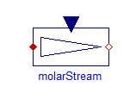
Chemical.MolarStream
q_in.q = solventFlow*q_in.conc;
q_in.q + q_out.q = 0;
Only forward direction!
Flow and q_out.conc are independent !
Input concentration q_in.conc is not in inStream() !
The value of flow-concentration is q/solventFlow.

Slide 9

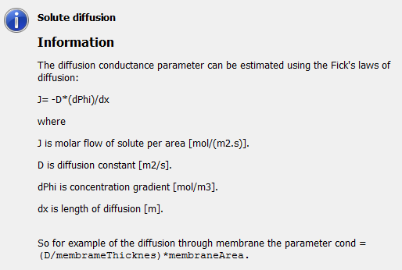
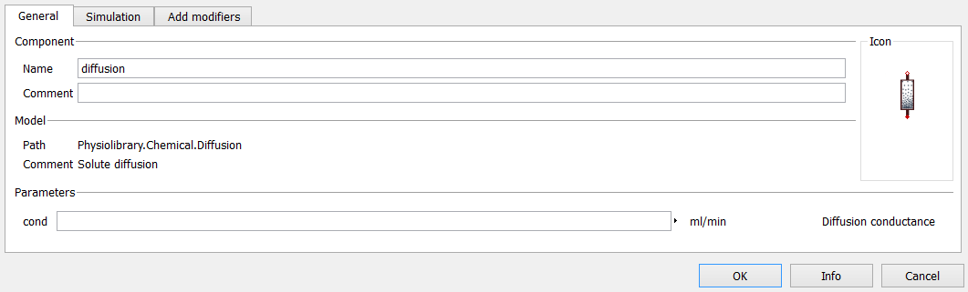
Chemical.Diffusion

Slide 10

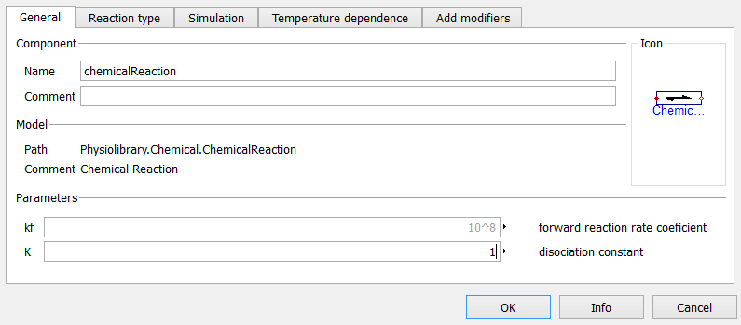
Chemical.ChemicalReaction
A <-> B, K=[B]/[A], kf*[A], kr*[B]

Slide 11
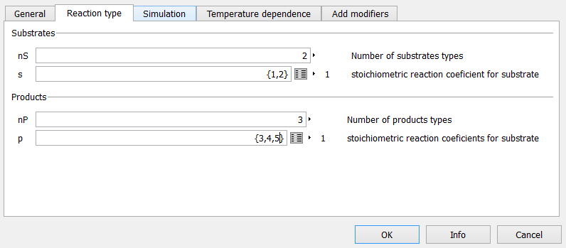
Type of ChemicalReaction
A + 2X <-> 3B + 4Y + 5Z, kf [A] [X]²,
K= ([B]³ [Y]⁴ [Z]⁵ )/([A] [X]²), kr [B]³ [Y]⁴ [Z]⁵

Slide 12
Chemical.GasSolubility
q_out.q = solubilityRateCoef*(q_out.conc - kH * q_in.conc);
q_in.q + q_out.q = 0;
Henry’s law of dissolved gas in liquid:
kH = [Xliquid]/[Xgas] … Henry's law constant

Slide 13
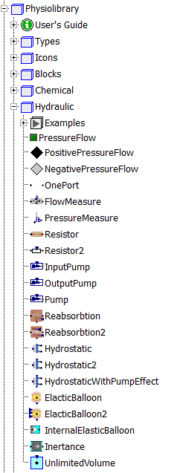

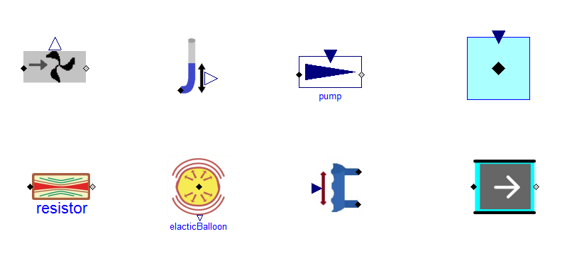
Hydraulic

Slide 14

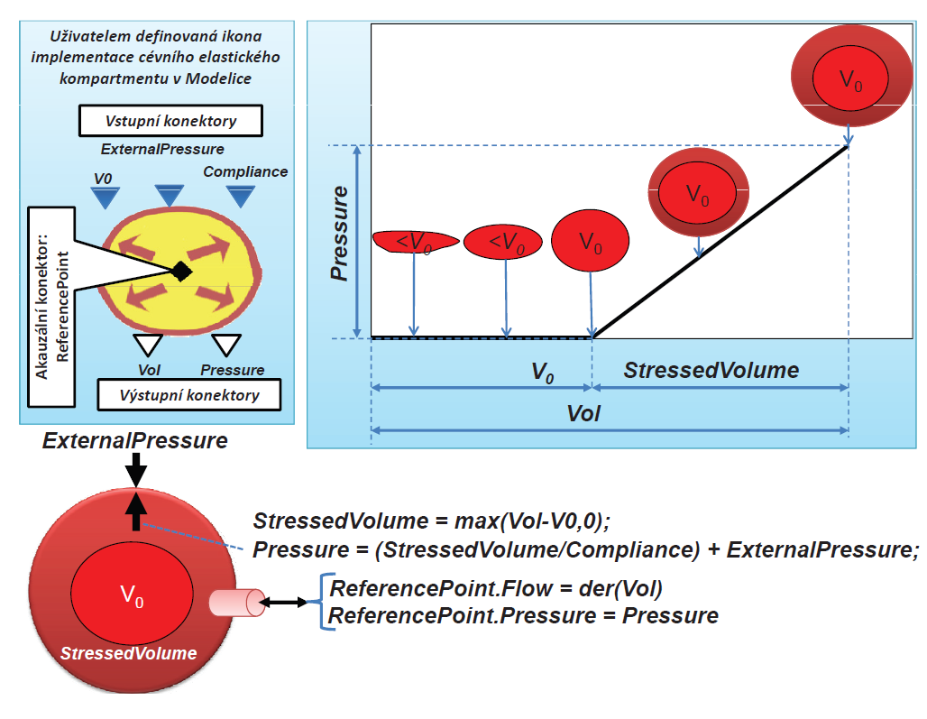
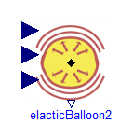
Hydraulic. ElacticBalloon

Slide 15

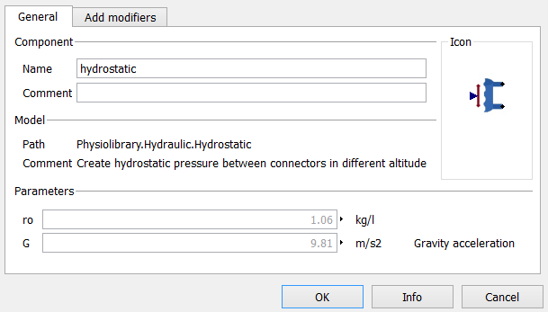

Hydraulic.Hydrostatic
Add pressure of hydrostatic column
q_down.pressure = q_up.pressure + G*ro*height;
q_up.q + q_down.q = 0;

Slide 16

Hydraulic.Inertia
I*der(q_in.q) = (q_in.pressure-q_out.pressure);
q_up.q + q_down.q = 0;

Slide 17
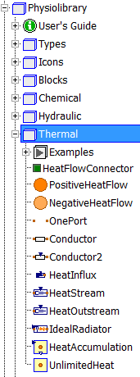

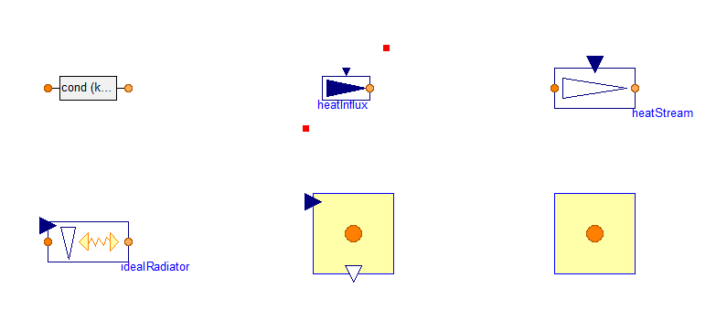
Thermal

Slide 18
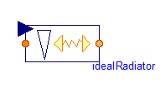
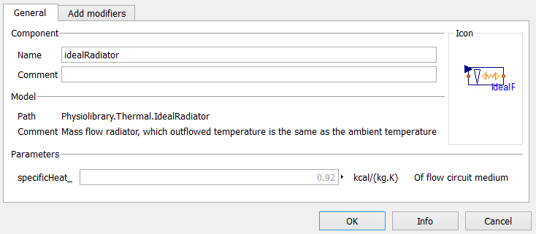
Thermal.IdealRadiator
q_in.q = substanceFlow*(q_in.T-q_out.T)*specificHeat_;
q_in.q + q_out.q = 0;

Slide 19
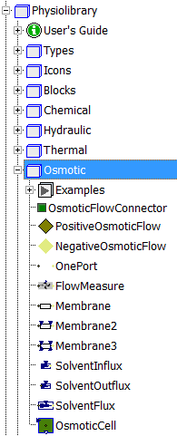
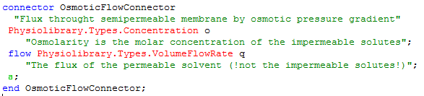
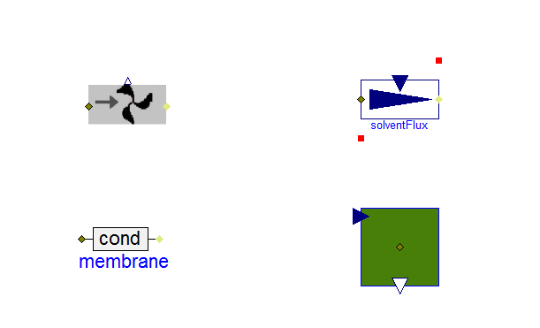
Osmotic

Slide 20
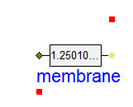
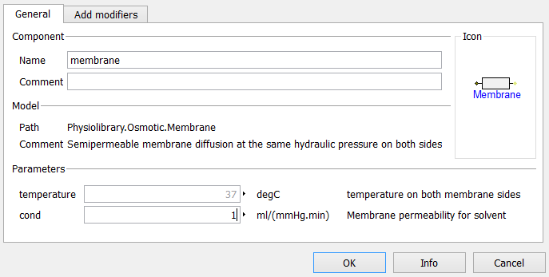
Osmotic.Membrane
q_in.q = cond * (
q_out.o*(Modelica.Constants.R*temperature)
- q_in.o*(Modelica.Constants.R*temperature));
q_in.q + q_out.q = 0;

Slide 21
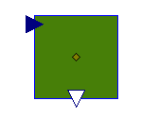
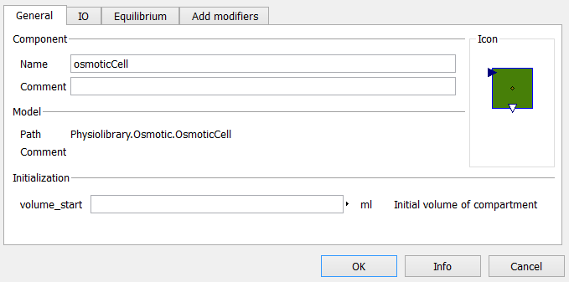
Osmotic.OsmoticCell
q_in.o = impermeableSolutes / volume;
der(volume)=q_in.q

Slide 22
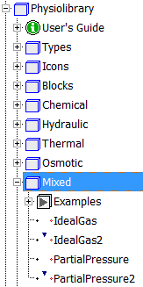
Mixed
Ideal gas equation
v.pressure = n.conc * R * T;
n.q + n.conc * v.q=0;
Partial pressure
= ideal gas equation + gas solubility

Slide 23
Thank you for attention!
Questions?

